Slide 1
Deep Learning Techniques for Music Generation - A Survey
Jean-Pierre Briot, Gaëtan Hadjeres, François Pachet
Cornell University , 5 Sep 2017

Slide 2
Outline
Ch2 – Method
Ch3 – Objective
Ch4 – Representation
Ch5 – Architecture
Ch6 – Strategy
Ch7 – System
Ch8 – Analysis
Ch9 – Other source
Ch10 – Discussion
Future work

Slide 3
Chapter2 - Method
Objective
a melody (temporal sequence of notes) , a full polyphony (chorale) with multiple voices , an accompaniment to a given melody
Representation
signal, transformed signal (ex: spectrum, via Fourier transformation), piano roll, MIDI, text, etc
Architecture
A lot of different learning method (RNN, CNN, Autoencoder . .. )
Strategy
Feedforward, Conditioning, Sampling, Input, Manipulation, Adversarial, Reinforcement, Unit, Selection, Compound, Strategies

Slide 4
Chapter3 - Objective
Melody (monophony)
voice (instrument or vocal) ,
1.monodic (at most one note at the same time)
2.polyphonic (more than one note can be played at the same time)
Polyphony
with multiple voices (intended for more than one voice or instrument)
Accompaniment
a counterpoint, composed of one or more melodies (voices),
a sequence of chords, that provides some associated harmony;
The association of a melody and chords
this is called a lead sheet and is common in Jazz – it may also include lyrics

Slide 5
the destination of the generated musical content
1. readable by the computer - audio or MIDI.
2. human readable - music score.
As deep learning for music generation is recent and basic neural networks techniques are non interactive, the majority of systems and experiments that we analyzed are not (yet) interactive. But the most interesting goal appears to be the design of interactive support systems for the musicians (for composing, arranging and other activities)
interchangeable (e.g., MIDI to score and vice-versa)
Notes:
不可轉換小部分
無法有好的互動 一個好的目標 – 讓系統能夠和音樂家能夠互動 ？ 協助做作詞作曲

Slide 6
CH4 - Representation
training input
The dataset used for training the deep learning system
generating input
The eventual data that may be used as input for the generation, e.g., a melody for which the system will generate an accompaniment, or a note that will be the first note of a generated melody
generated output
The objective of the generation.
Signal (waveform or spectrum) , Symbolic(MIDI ,piano roll ,text . . .)

Slide 7
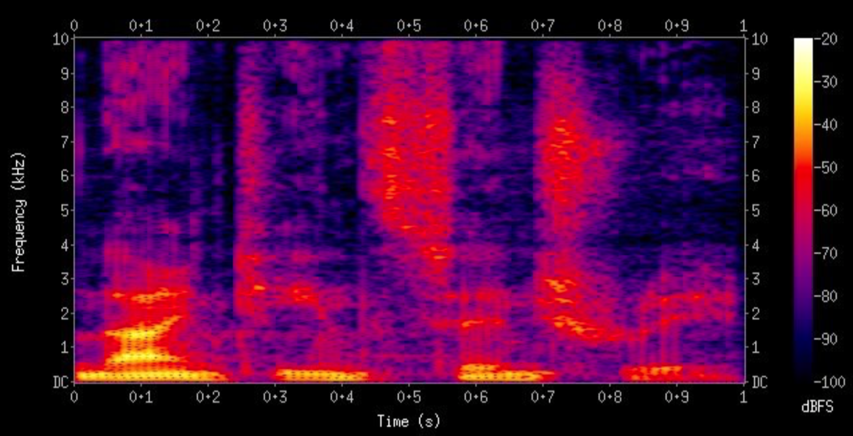
Signal
raw audio signal (waveform)
audio spectrum, via a Fourier transform.
Symbolic
MIDI Piano Roll Text
Chord Leader Sheet Rhyme

Slide 8
MIDI (Musical Instrument Digital Interface)
MIDI
Signal
voice
mode
System
normal
Real-time
special
Notes:
頻道聲音訊息 開始聲音 結束聲音 變更音色
頻道模式訊息 結束所有 結束所有狀態 reset
系統訊息*3 廠牌之間交換的訊息 (可能是音色的變換？

Slide 9
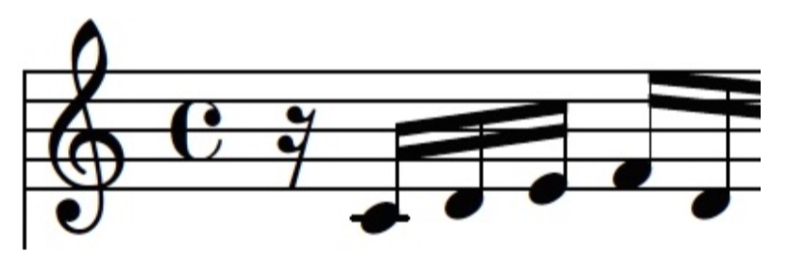
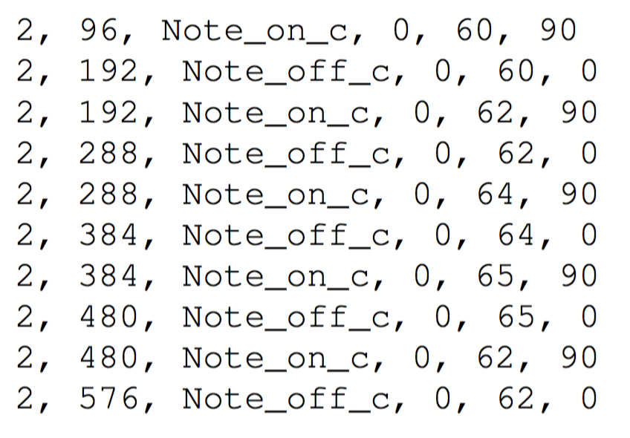
84 ticks per quarter note , which corresponds to 96 ticks for an eighteenth note )
one drawback of encoding MIDI messages directly is that it does not effectively preserve the notion of multiple notes being played at once through the use of multiple tracks. Since they concatenate tracks end-to-end, they posit that it will be difficult for such a model to learn that multiple notes in the same position across different tracks can really be played at the same time
Notes:
每分鐘多少拍->一拍多少個ticks (ticks一般自己定義 越細即可描繪得越細膩)
多軌的聲音不容易完全的在同一個時間點開始進行 學出來的聲音可能常常不再同一個時間點出發

Slide 10
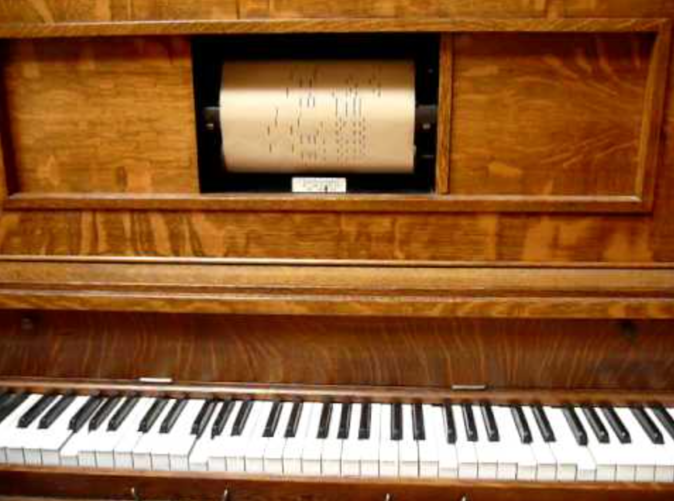
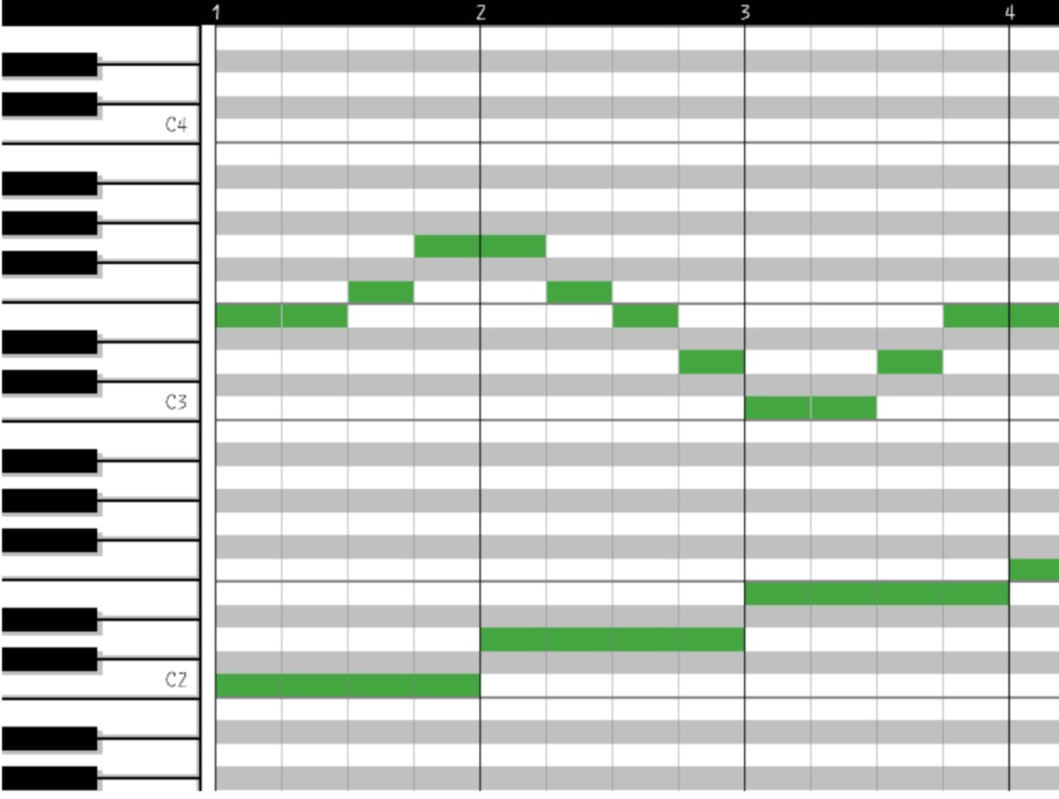
Piano roll
Notes:
很難分辨連續相同音和連續音？

Slide 11
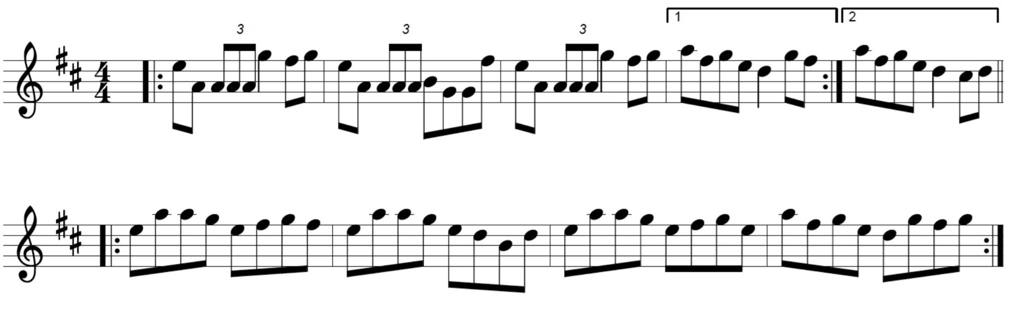
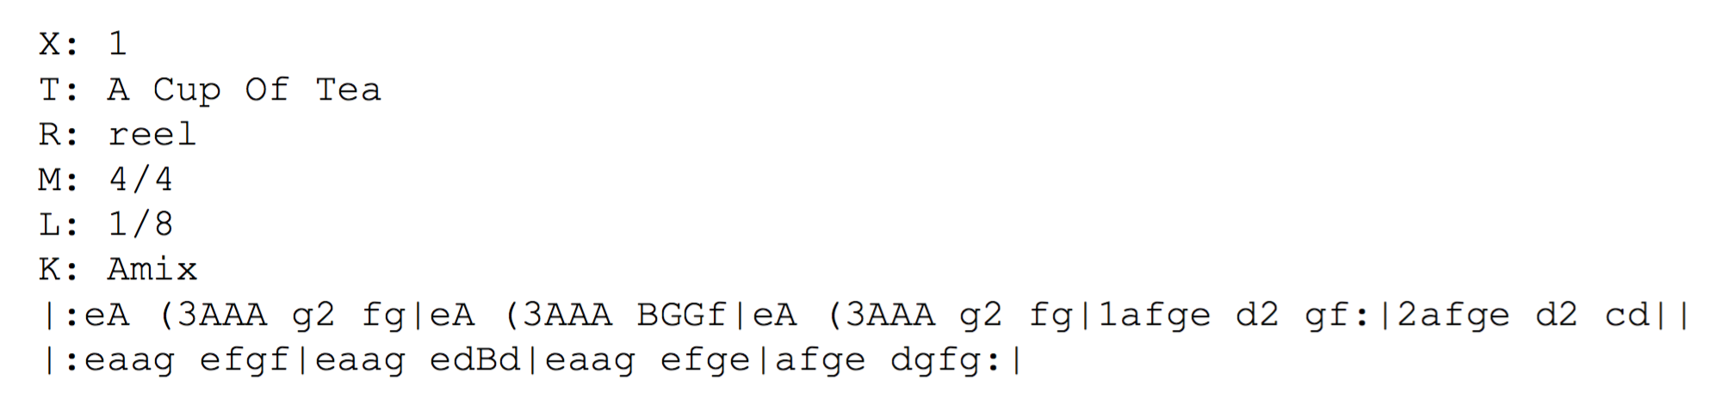
Text
Notes:
有利於得知調性的變化

Slide 12
Chord
the pitch class of its root note (e.g., C, A. . . ) and its type (e.g., major, minor, dominant seventh. . . ), usually using an abbreviated jazz notation, e.g., C, D-, E7
An interesting alternative representation of chords, named Chord2Vec (inspired by the Word2Vec model for natural language [70]), has been recently proposed in [68] )
Notes:
[68][70] chord2Vec 將和弦當作文字，利用類似word2Vec的方式推測附近的和弦

Slide 13
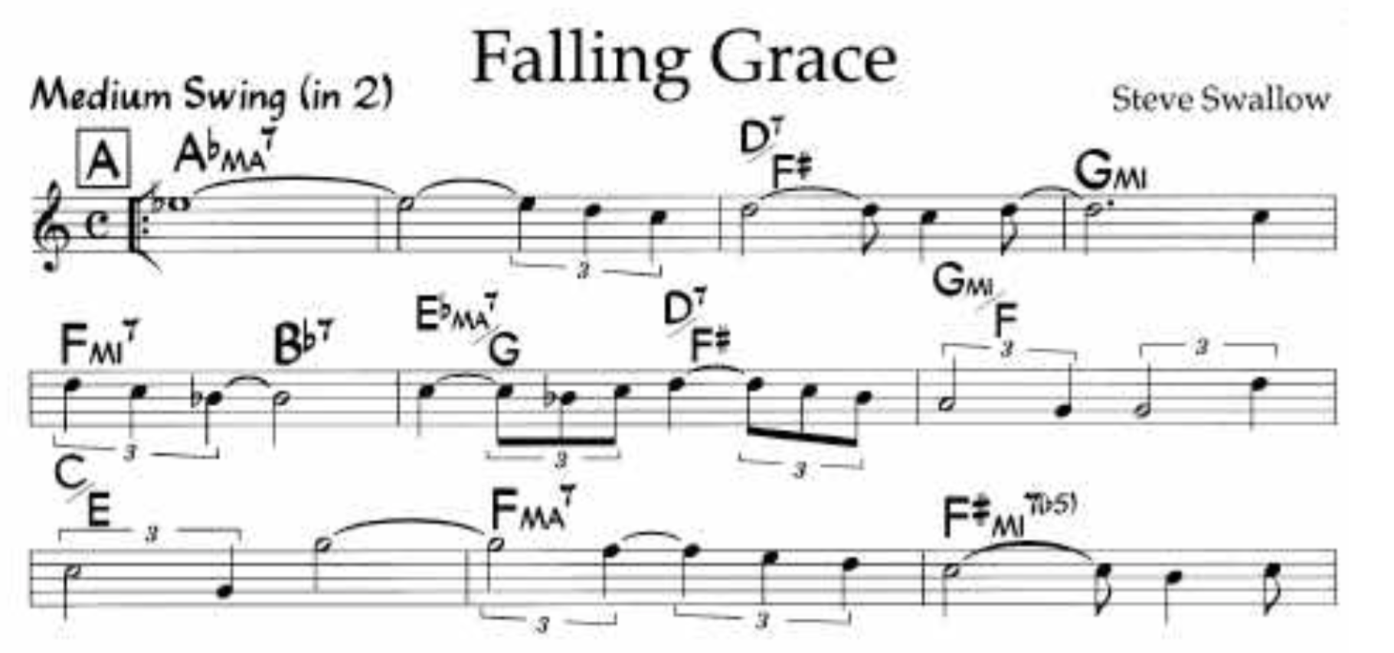
Lead Sheet
Lead sheets are an important representation format for popular music (Jazz, pop. . . )

Slide 14
Common Issues and Techniques
Global vs Time Slice – (1) global (2) Time Slice (3) note slice
Note Ending - (1) special tag (2) computing unit
Time Quantization - (1) smallest duration of a note (2) note
Feature Extraction - Chord2Vec
Input Encoding - (1) value encoding (2) item encoding
Meta Data - ex : note ties , instrument associated to a voice
Transposition - ex: transpose all examples in all keys
Notes:
Note encoding 兩個連續的八分音符和一個四分音符 1.一個特別的tag代表是否為結束 2.計算時間在開頭就標示此因會有多長
Time quantization – 1. 以最小的音符為單位 2.以音符為單位
Input encoding 1.類比的情況下或多或少會有失真 2.需要準確的話基數需要很龐大
Note ties 圓滑音
Transposition 轉調 調整所有的trainning data成相同的調
DataSet 目前沒有較大型的標準 JSB是相對較大的 （網站掛掉了）

Slide 15
Global vs Time Slice
Global
no notion of temporal sequence and no explicit notion of time. The granularity of processing by the deep network architecture is the representation as a whole. The architecture used is not recurrent
Time Step (Time Slice)
The granularity of processing by the deep network architecture is a time step. Note that the time slice is usually set to the shortest note duration
Note Step
There is no fixed time step. The granularity of processing by the deep network architecture is a note.

Slide 16
DataSet
Piano-midi.de: classical piano pieces (http://www.piano-midi.de/)
Nottingham : over 1000 folk tunes (http://abc.sourceforge.net/NMD/)
MuseData: electronic library of classical music scores (http://musedata.stanford.edu/)
JSB Chorales: set of four-part harmonized chorales (http://www.jsbchorales.net/index.shtml)
FMA: A Dataset For Music Analysis (https://github.com/mdeff/fma)
http://deeplearning.net/datasets/
Notes:
DataSet 介紹在第27頁
JSB暫時不能用

Slide 17
Chapter5 - Architecture
Linear Regression
Basic Building Block
Basic Architectures
Multiple neural networks (Feedforward)
autoencoders
restricted Boltzmann machines (RBMs)
recurrent networks (RNNs)
Conditioning Architectural Pattern
Generative Adversarial Networks (GAN)
Reinforcement Learning

Slide 18
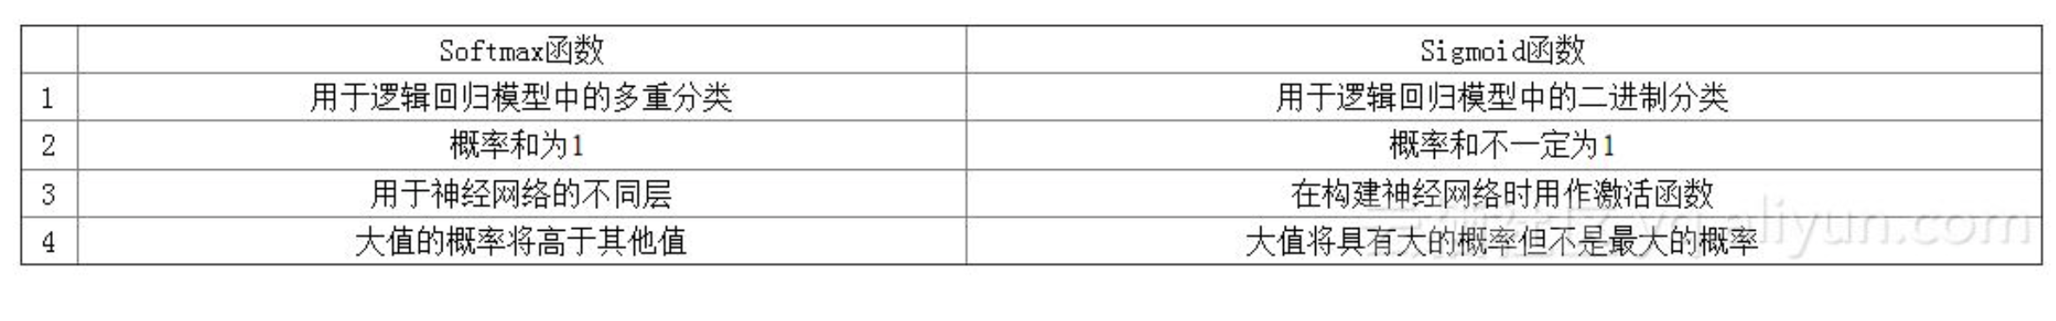
中間都是ReLU
three possible types of activation function for the output layer:
identity – This is the case for so-called linear neural networks, for a prediction task with output values being continuous. Therefore there is no non linear transformation at the last layer.
sigmoid – It is used for binary classification, as in logistic regression13 (which is indeed equivalent to linear regression with the addition of the sigmoid as activation function)14. The sigmoid function (usually written s) is defined at Equation 5.3 and is displayed at Figure 5.10.
• softmax function15 – This is the most common approach for a classification task with more than two classes, and also for a prediction task with a discrete value (as for in- stance to predict the pitch of a note), where a one-hot encoding is generally used (see Section 4.4.5). Indeed, this is a reformulation of a prediction (regression) task for a single value as a classification between different possible discrete values.

Slide 19
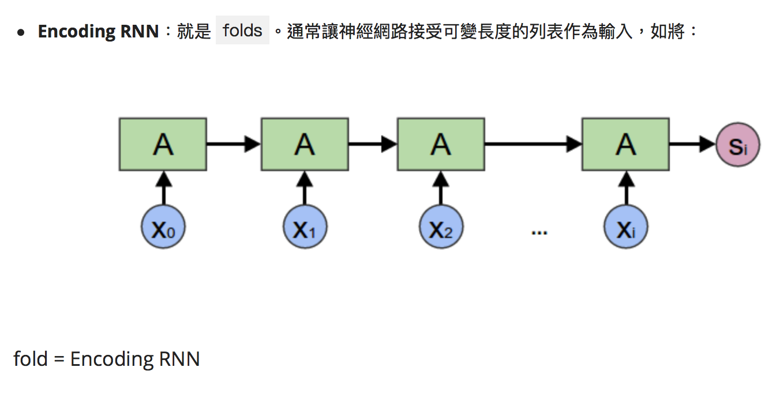
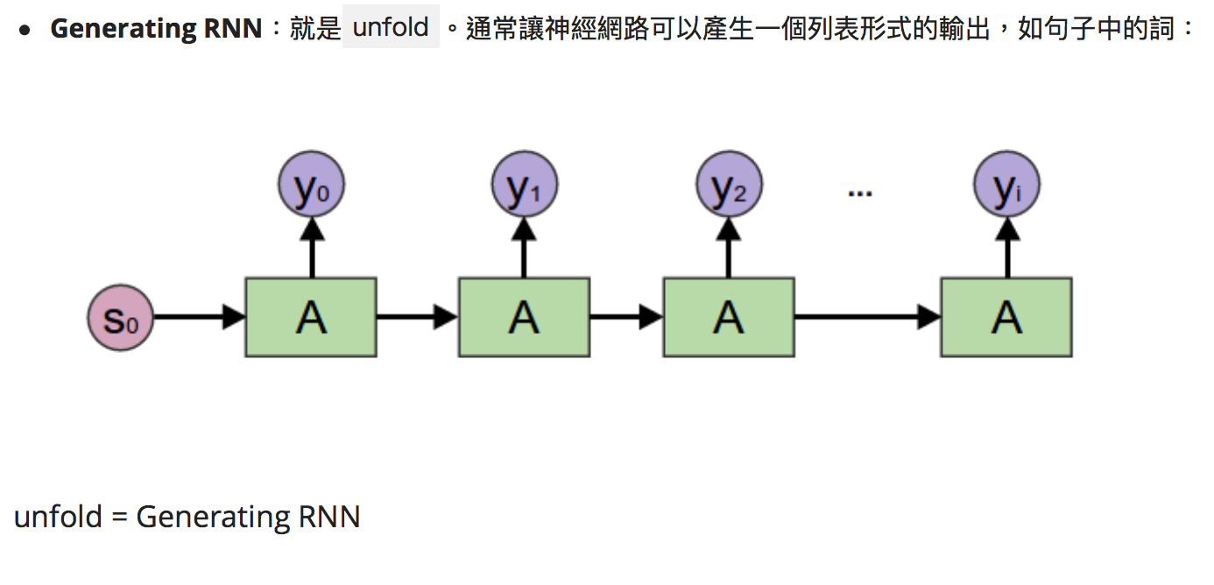
Folded & Unfolded RNN

Slide 20
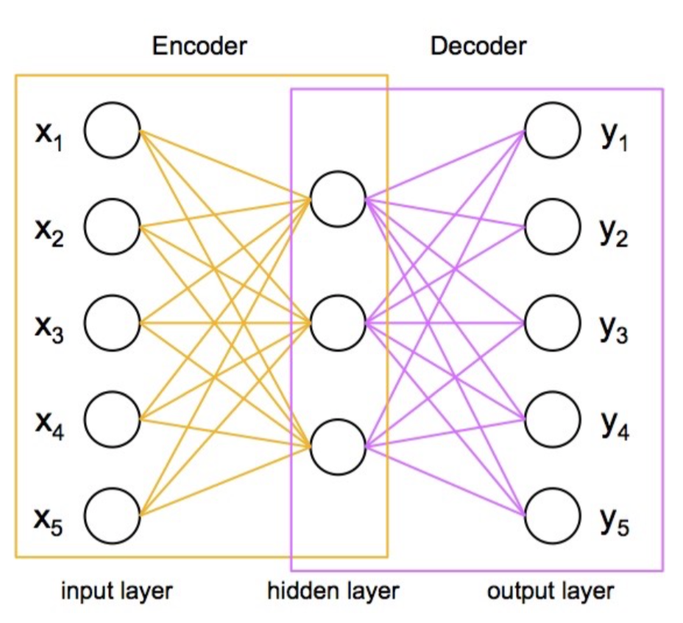
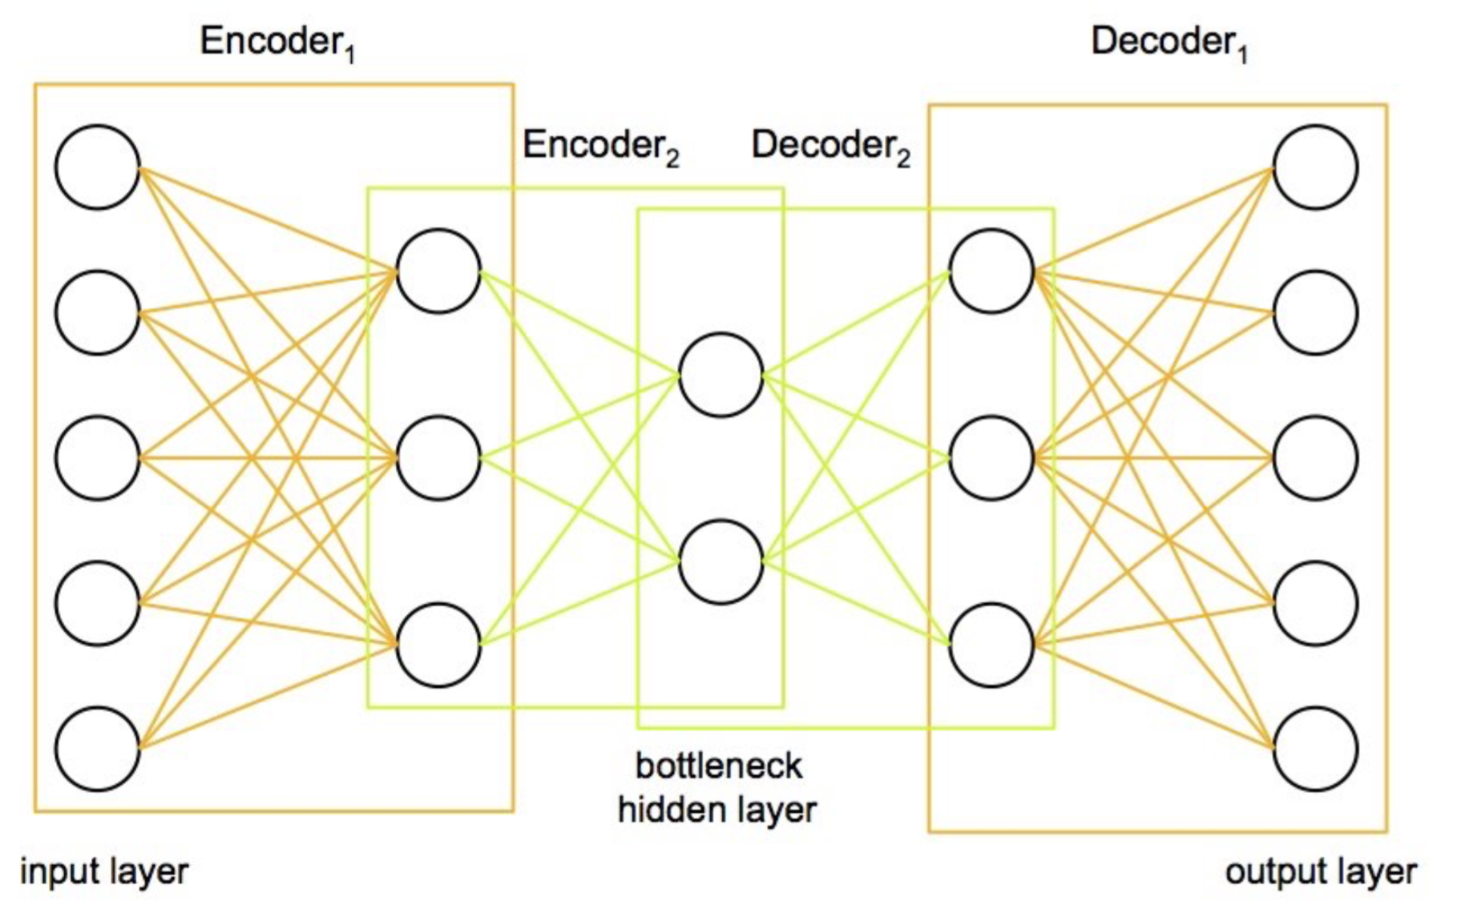
Autoencoder
the hidden layer has often fewer nodes than the input layer
Stacked autoencoder
autoencoder
Notes:
輸入雜訊圖片或模糊照片 ->輸出清晰影像
或者壓縮

Slide 21
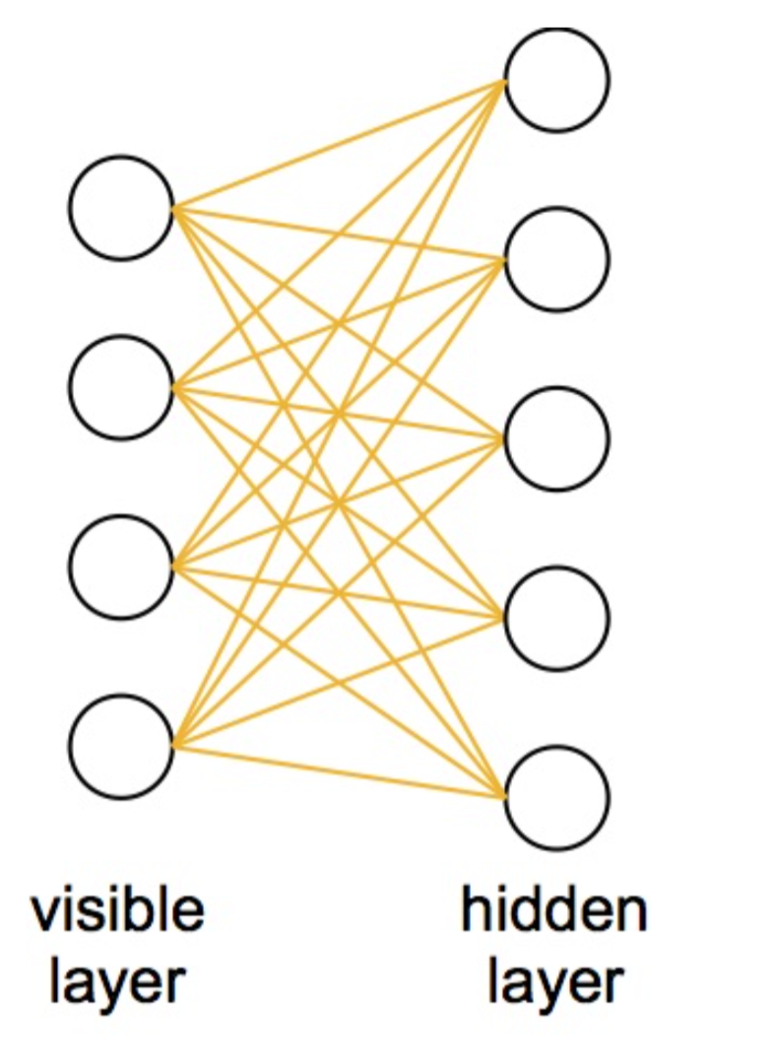
RBM (Restricted Boltzmann Machine )
Similarity with an autoencoder. Two differences:
1. no ouput – the input acting also as the output
2. stochastic (opposed to neural networks and autoencoders
Notes:
X =外積

Slide 22
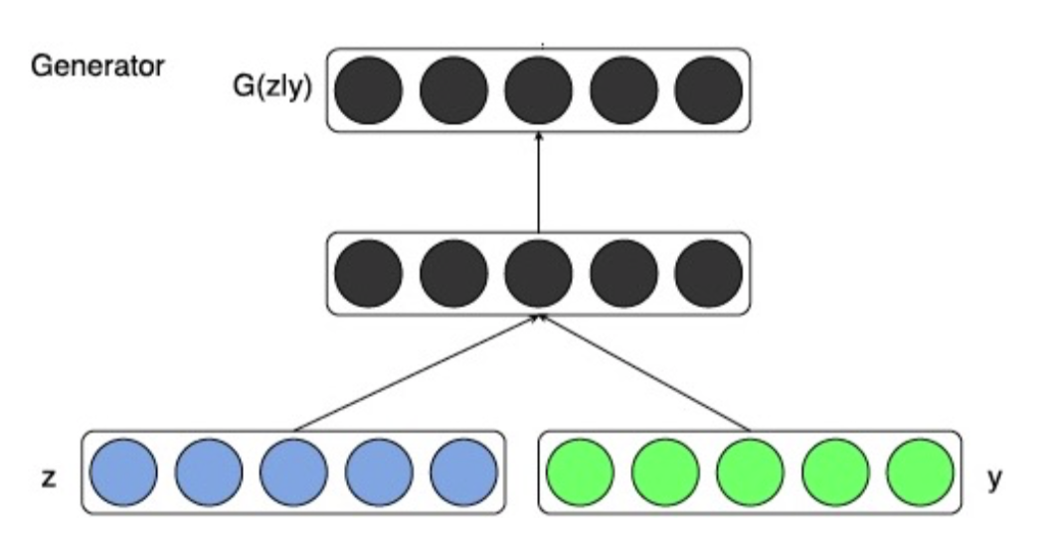
Conditioning Architectural Pattern
Notes:
extra conditioning information
也可以拿來作為使用者的控制用
global or local

Slide 23
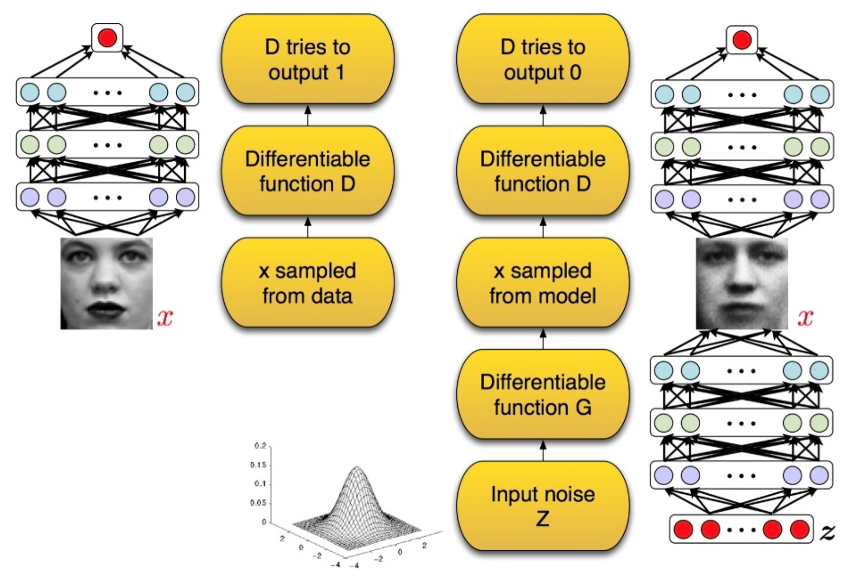
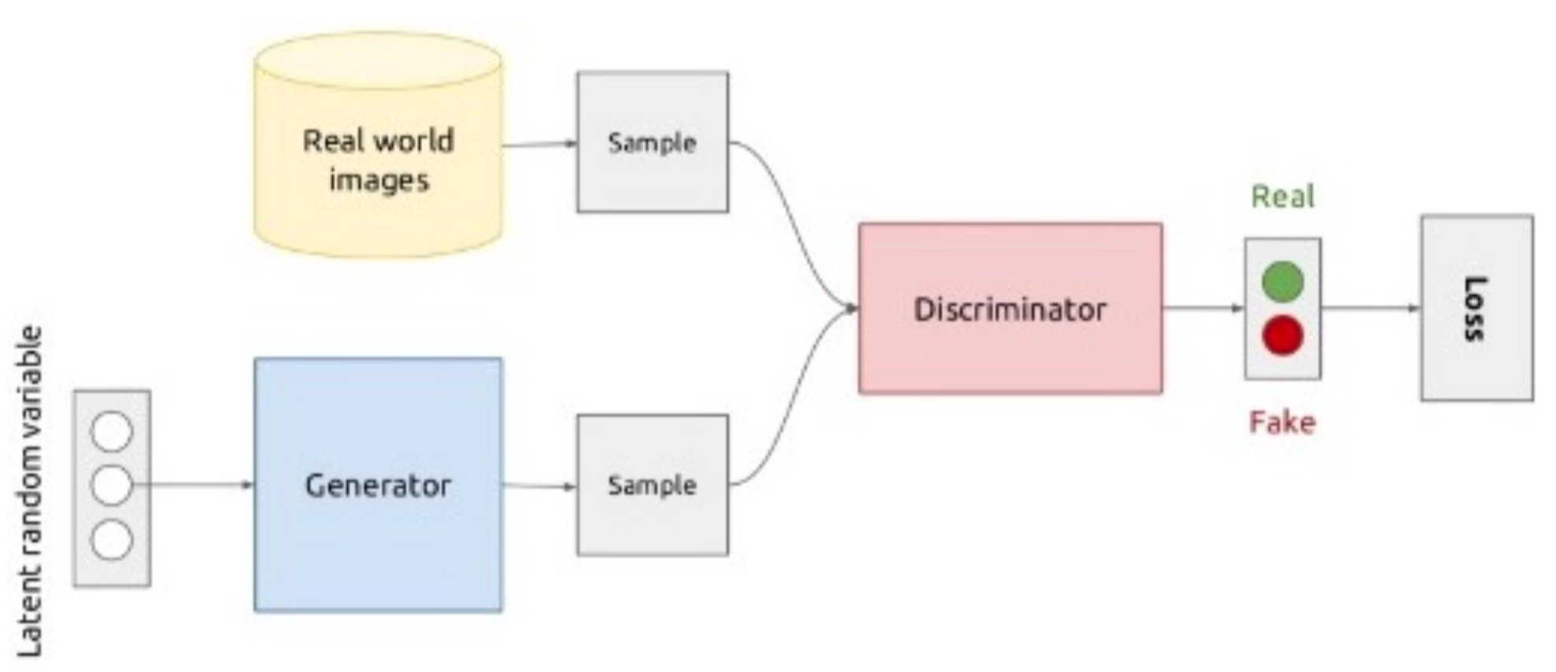
GAN(Generative Adversarial Networks)
V(G,D)is the objective, which D will try to maximize and which G will try to minimize;
D(x) represents the probability (according to D) that input x came from the real data;
D(G(z)) represents the probability (according to D) that input G(z) has been produced by G from z random noise;
1-D(G(z)) represents the probability (according to D) that input G(z) has not been produced by G from z random noise;
Notes:
零和博弈論 -自己的幸福是建立在他人的痛苦之上的，二者的大小完全相等，因而雙方都想盡一切辦法以實現「損人利己」。零和博弈的例子有賭博、期貨和選舉等
5.3.10

Slide 24
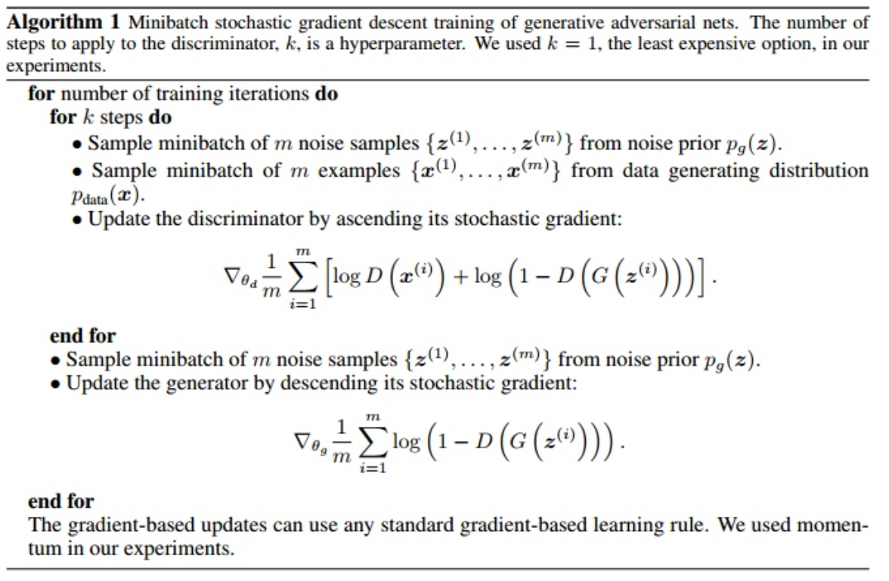
D
G

Slide 25
Reinforcement Learning –Deep Double Q
Deepmind
. . .

Slide 26
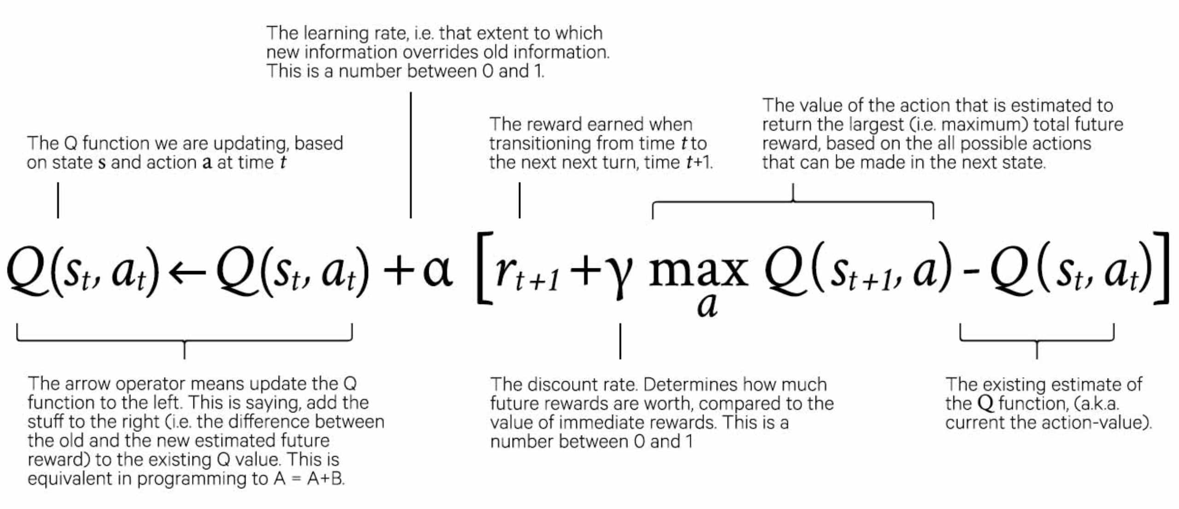
Q learning

Slide 27
Chapter6 - Strategy
Feedforward
Conditioning
Sampling
Input Manipulation
Adversarial
Reinforcement
Unit Selection
Compound Strategies
Notes:
Adversarial - 對抗 ＧＡＮ才有

Slide 28
Chapter7 - Systems
Sampling & Conditioning & Feedforward Strategies
Input Manipulation & Feedforward Strategies
Sampling & Input Manipulation Strategies
Adversarial & Conditioning & Feedforward Strategies
Reinforcement & Feedforward Strategies
Unit Selection & Feedforward Strategies

Slide 29
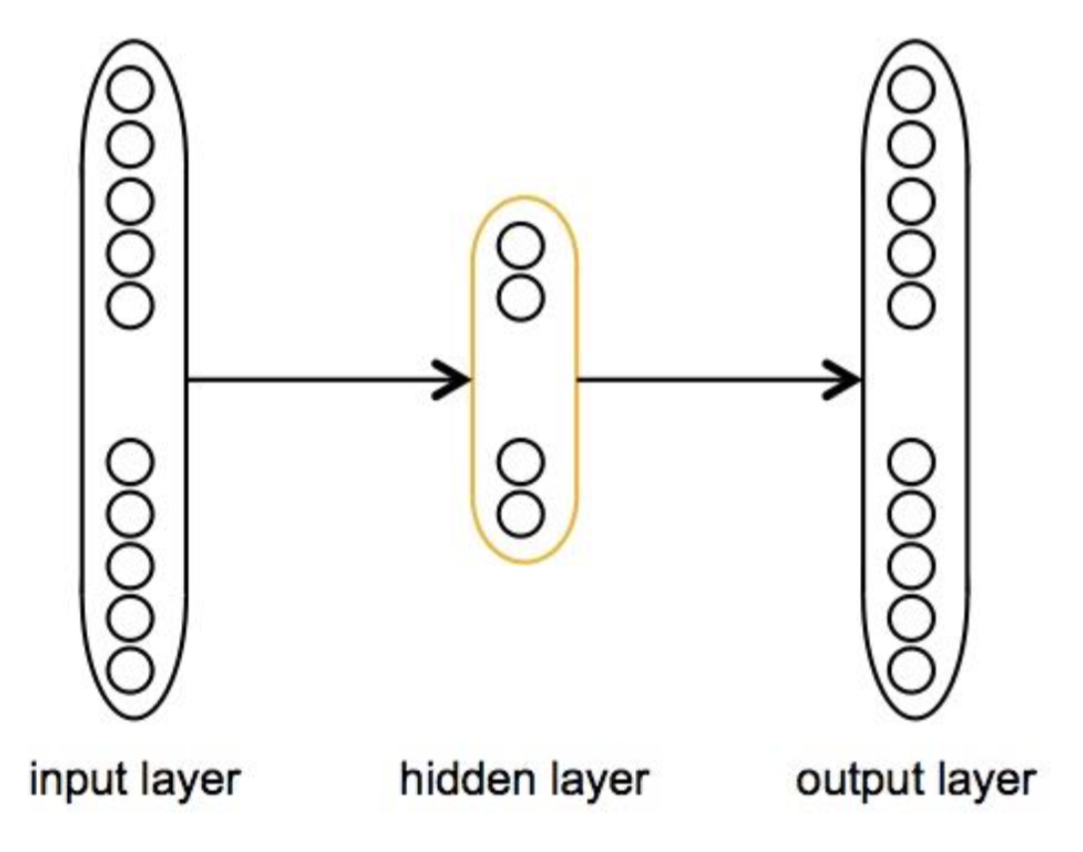
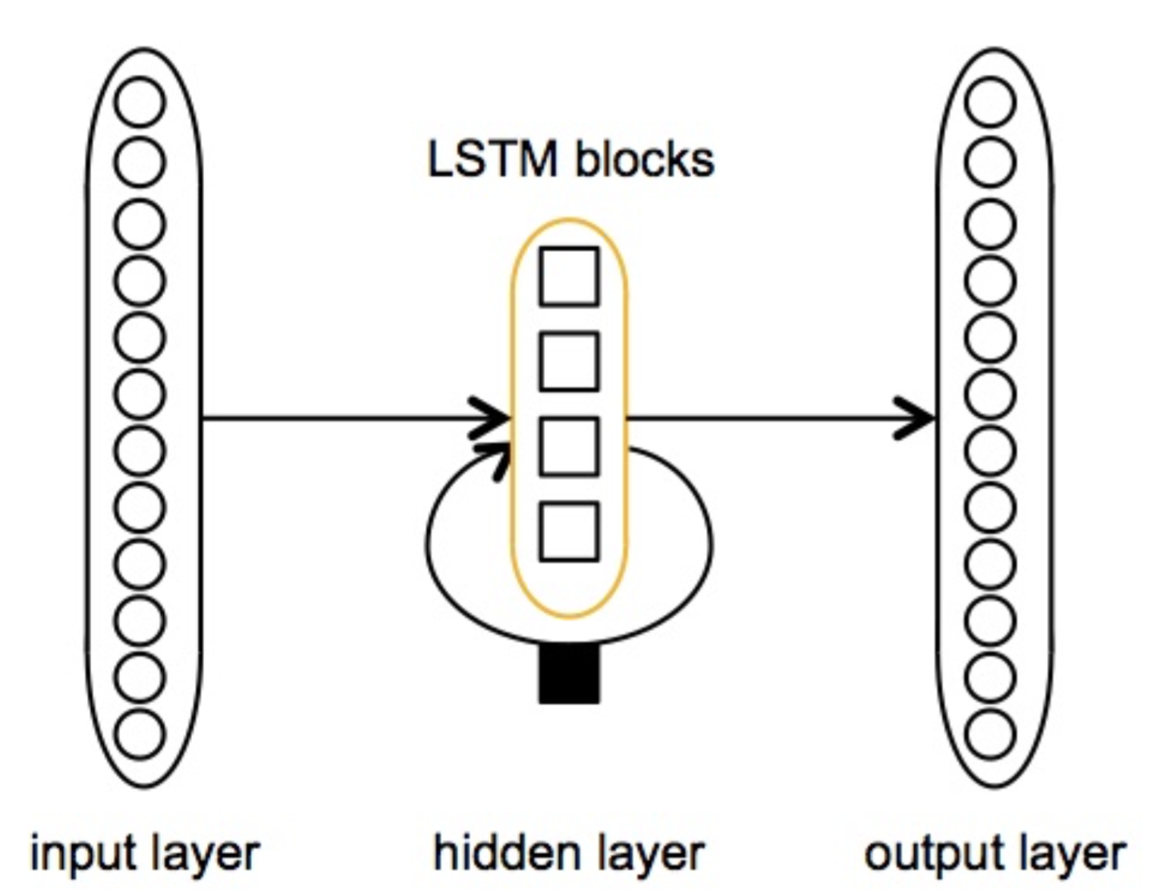
Feedforward Strategy
MiniBach
Interestingly, we have not found (yet) an example of such a simple strategy
Input- 2,832 nodes
output- 2,896 nodes
hidden layer - 200 units, ReLU
Activate function – softmax
Melody –S ,A ,T ,B
DataSet – 352example
Eck and Schmidhuber’s Blues Melody Generation System
2 types of sequences: melody and chords
LSTM

Slide 30
Liang’s BachBot Chorale Generation System
Sturm et al.’s Celtic Melody Generation System
LSTM
folk-rnn textual notation
Input is texture (ABC)
3 Layers is best.
LSTM
polyphonic music
Notes:
專門foccus在塞爾提克風格 輸入是abc格式

Slide 31

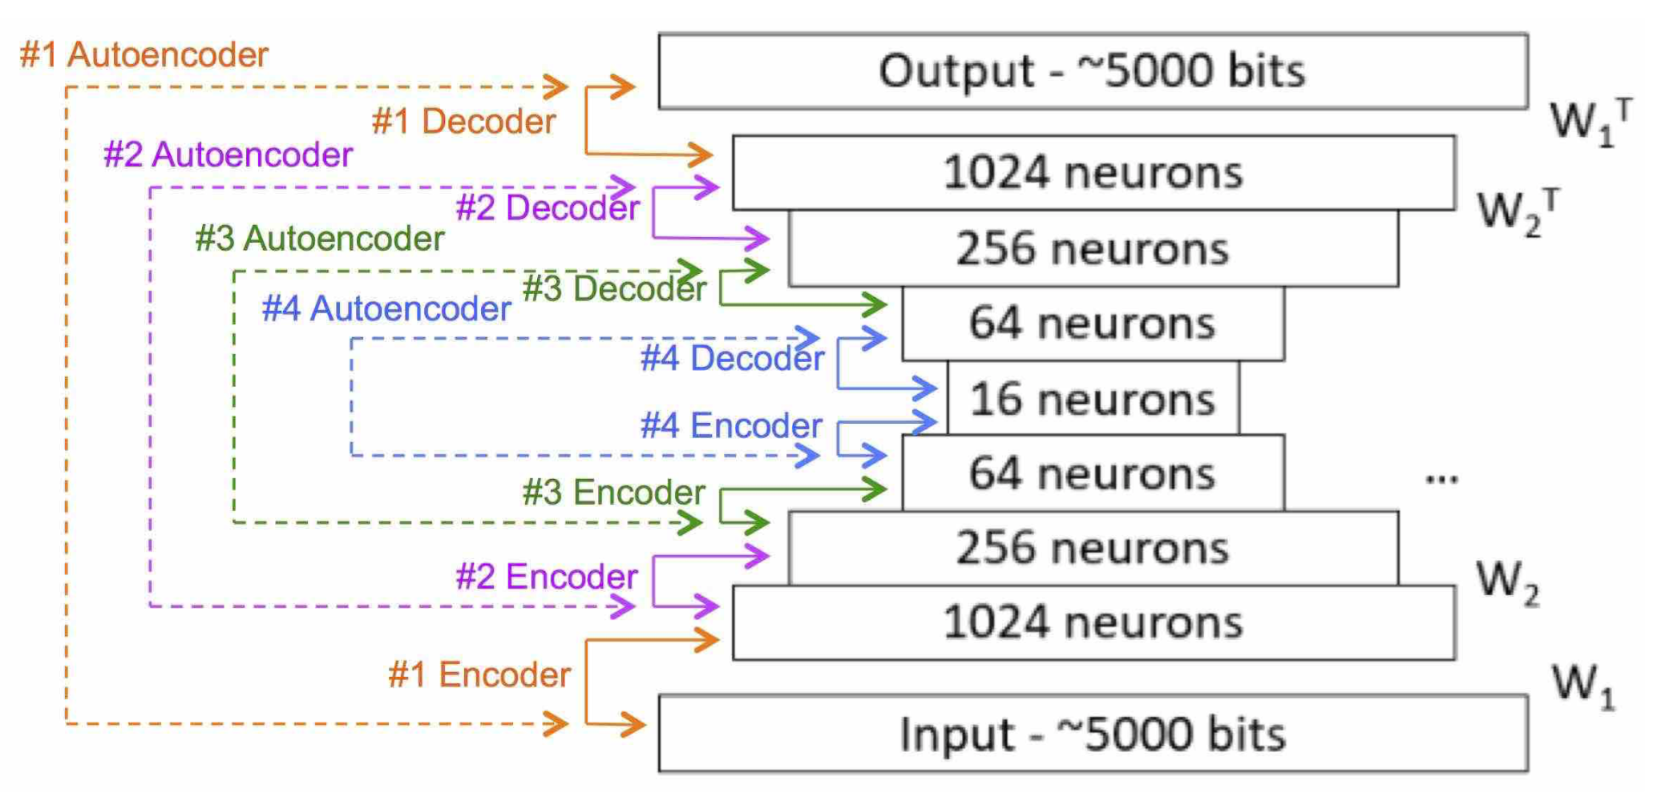
Stacked Autoencoders Architecture
Sun’s DeepHear Ragtime Melody Generation System
Data set - 600 measures of Scott Joplin’s ragtime music , nodes is around 5000
He measured the similarity and found that, on average, its value is 59.6% . but does not prevent most of generated pieces to sound different.
DeepAutoController
Same as Deephear
Use audio generated by FFT
Notes:
https://github.com/woodshop/deepAutoController

Slide 32
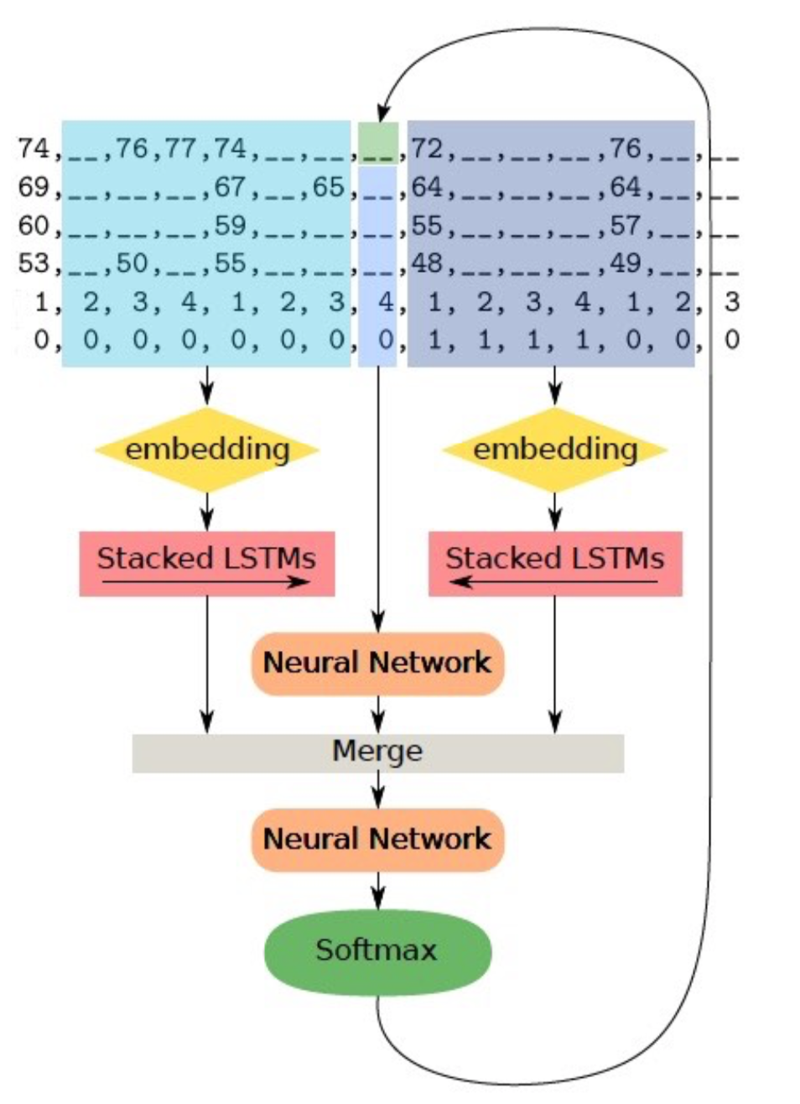
Feedforward & RNN Architectures
Hadjeres et al.’s DeepBach Chorale System
specialized for Bach chorales
two recurrent (LSTMs) and two feedforward networks
considers the two directions forward and backwards in time.
Train -
4 times, one for each voice
Transpose (C or Am)
Two special representaion :
hold symbol ( _ )
real names and not their MIDI pitches
(e.g., F# is different from a Gb)
Generation - Gibbs sampling (simple version )
Notes:
21 for the soprano, alto and tenor parts; and 28 for the bass part
表示法：
暫停
調性(區隔屬於哪個調)
DeepBatch – 一次全部 在迭代至穩定
Gibbs sampling markov chain抵達平衡
400 多名音樂專業人士在內的 1600 多人試聽了同樣旋律的不同和聲，當播放 DeepBach 產生的和聲時， 有半數人都認為這是巴哈的作品 。

Slide 33
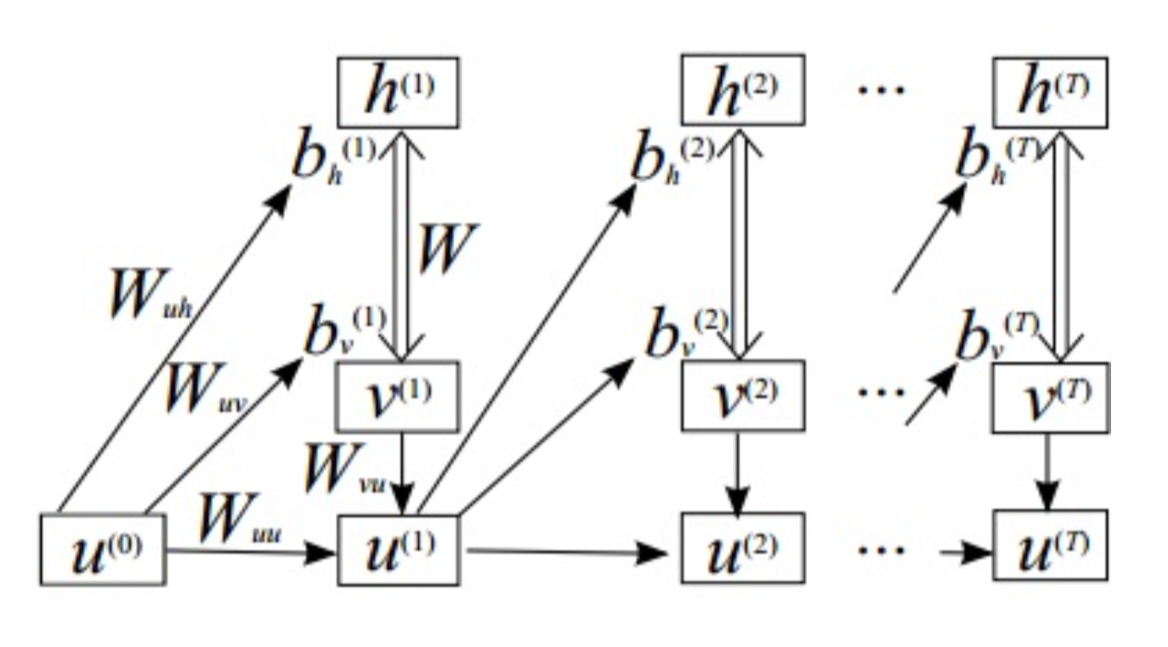
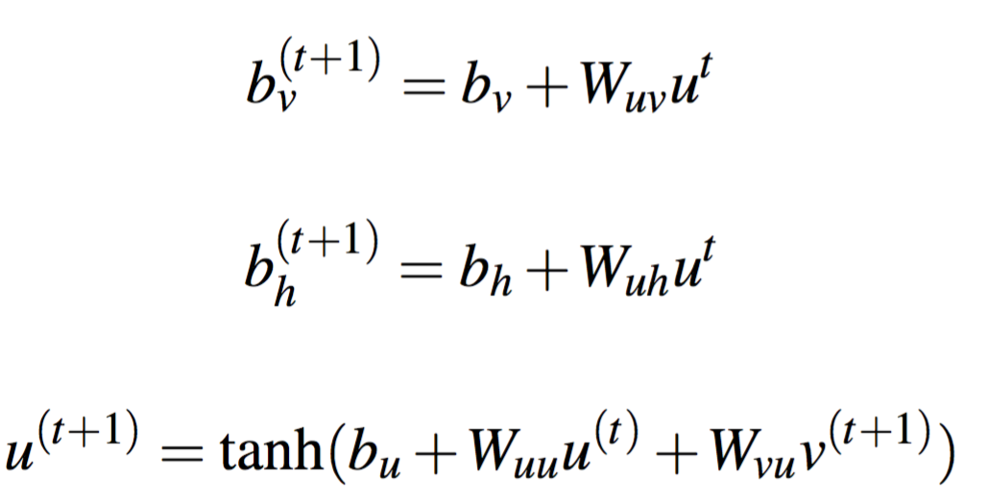
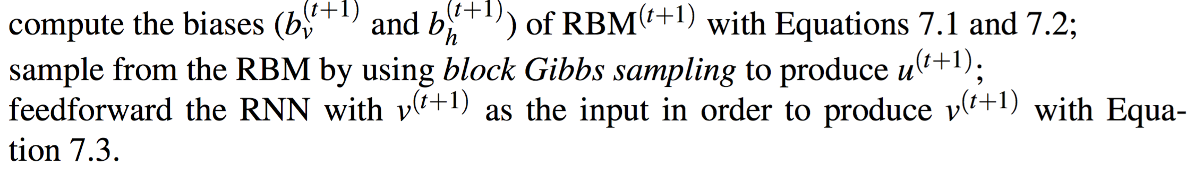
RBM Polyphonic System
non-Boolean model of RBM
RNN-RBM Polyphonic System

Slide 34
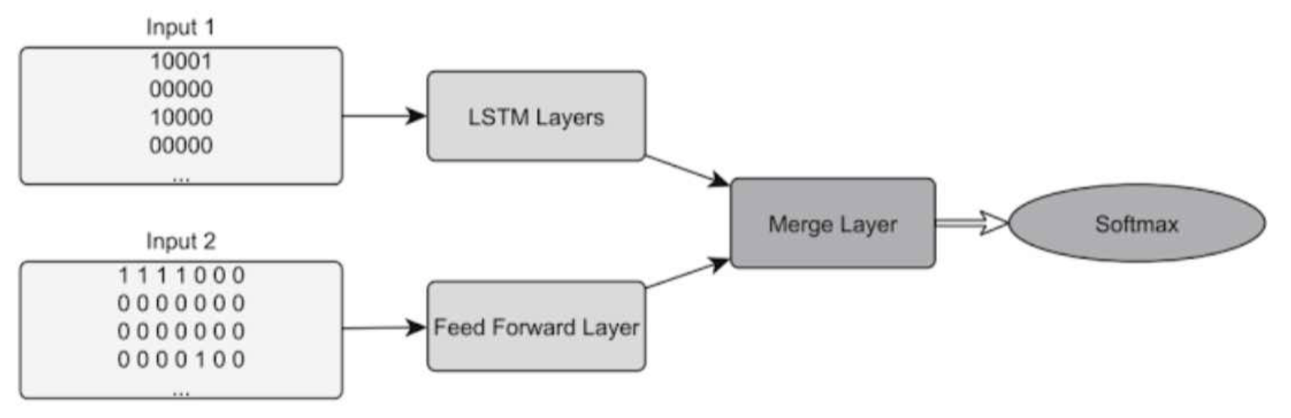
Makris et al.’s Rhythm Generation System
rock bands tablatures from the Web and converted to MIDI
drums - 5 components (ex :11101) , Bass – 4(?)+3 component
Notes:
4+3 平穩 漸強 漸弱 ,

Slide 35
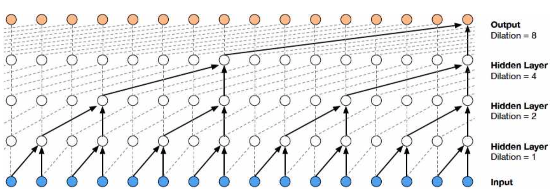
WaveNet Audio Generation System
multi-speaker, text-to-speech (TTS) and music
per time step – 65,536 -> 256 be tractable
Dataset – (1) 200 hours of music audio (2) YouTube piano solo 60hr
Dilated casual convolution
Notes:
還未完成

Slide 36
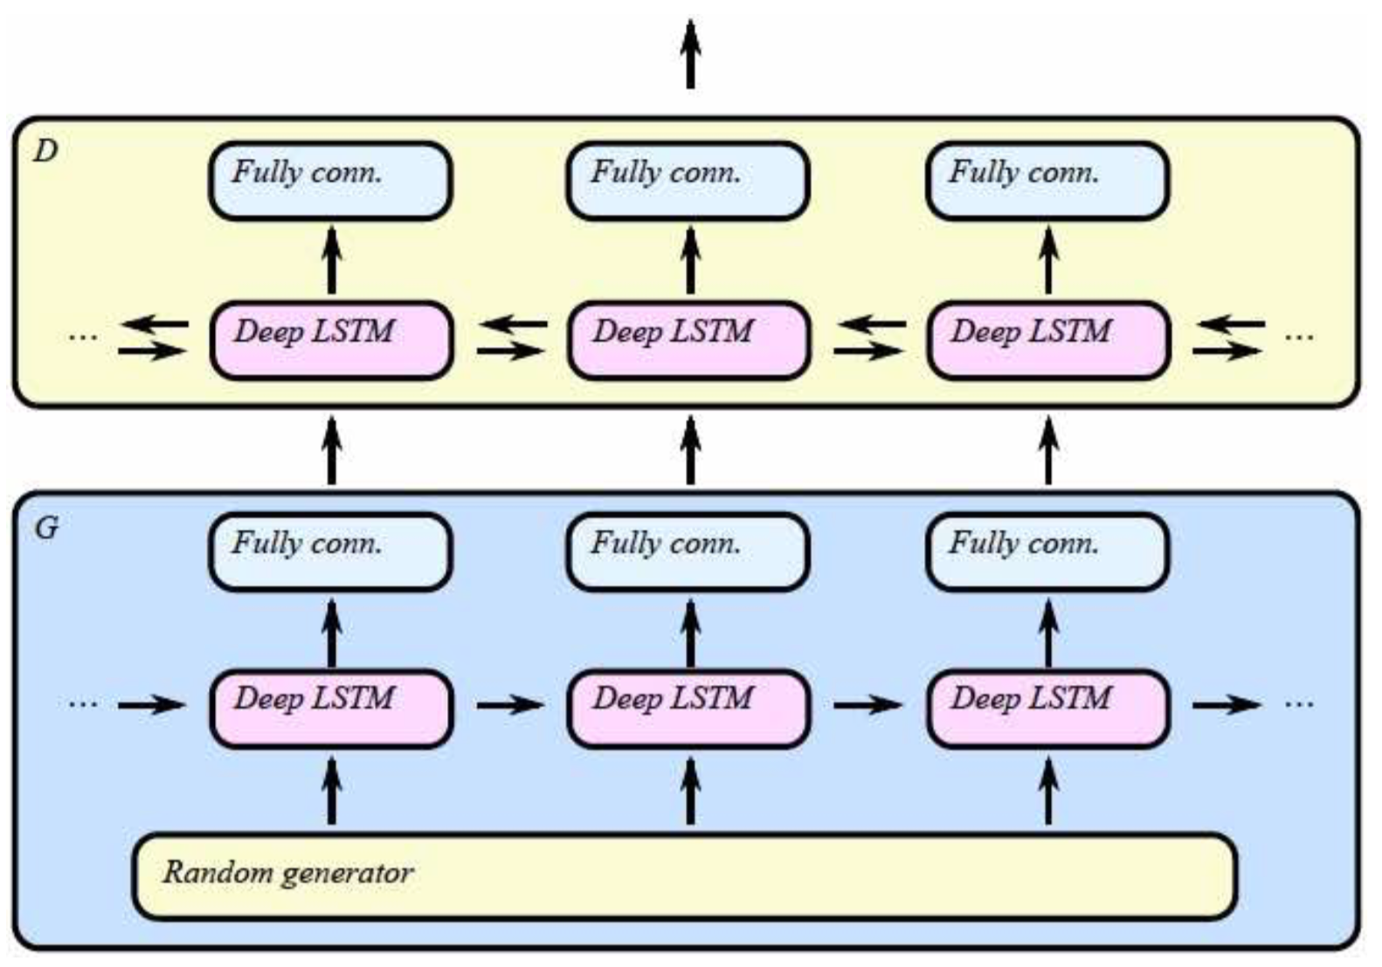
C-RNN-GAN Classical Polyphony Generation System
Representation :
1.duration 2.pitch
3.intensity 4. time spent
Dataset - classical music(MIDI)
3,697pieces from 160 composers
GAN but D and G are RNN(LSTM)
RNN is bidirectional
Notes:
The author states that the model trained with feature matching22 gets a better trade-off between structure and sur- prise than the other variants.

Slide 37
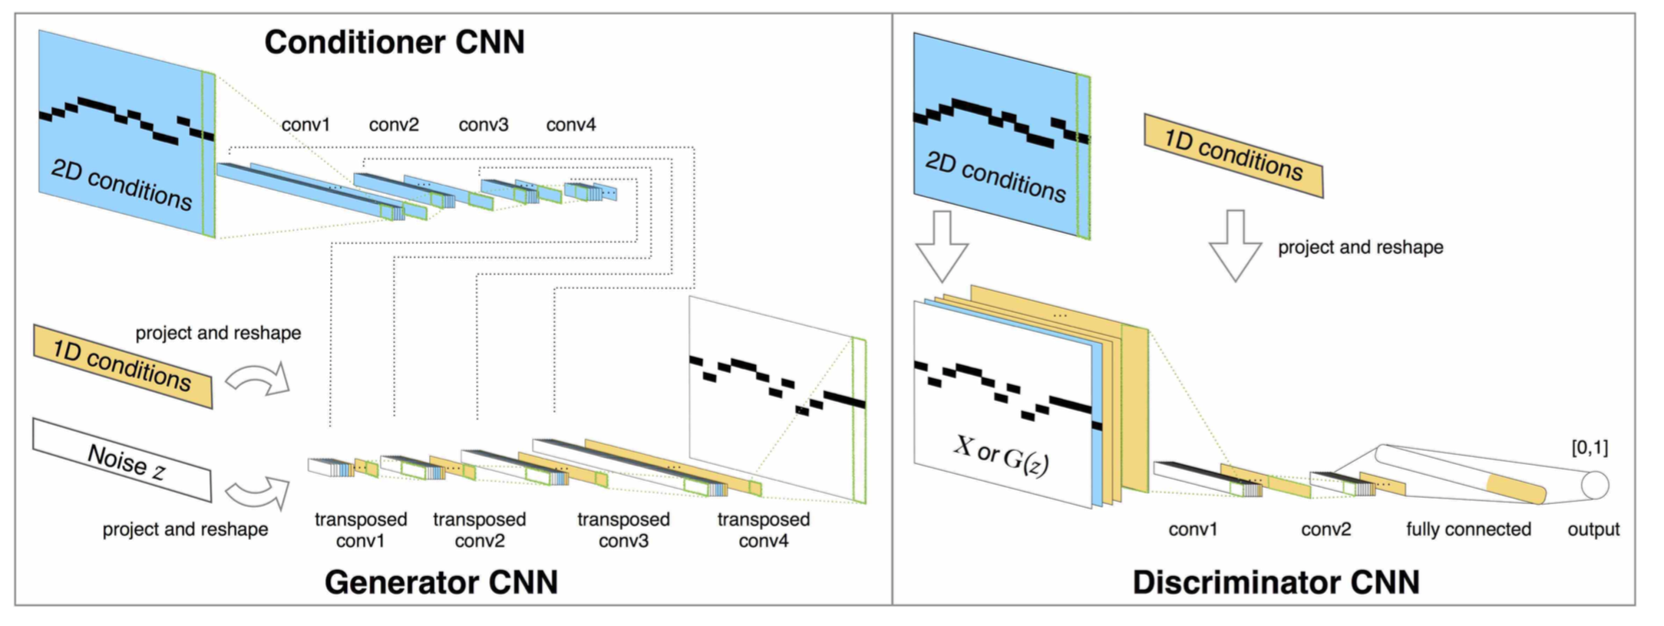
MidiNet Pop Melody Generation System
Dataset – 1022pop music (from tablatures TheoryTab )
transpose to same 2 octaves-> 50,496 bars
Granularity is measure(not the smallest note).
Major or minor
Chord
Notes:
GAN
輸入 開頭的一小段旋律或和弦進行
condition
1.M or m 2.和弦進行
建立獨創性
1. 只把condition加在Ｇ後半段(降低condition的維度)
2. 降低數量

Slide 38
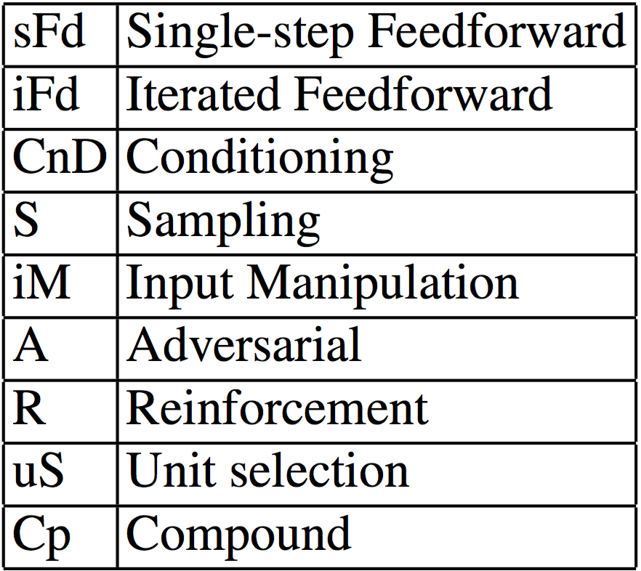
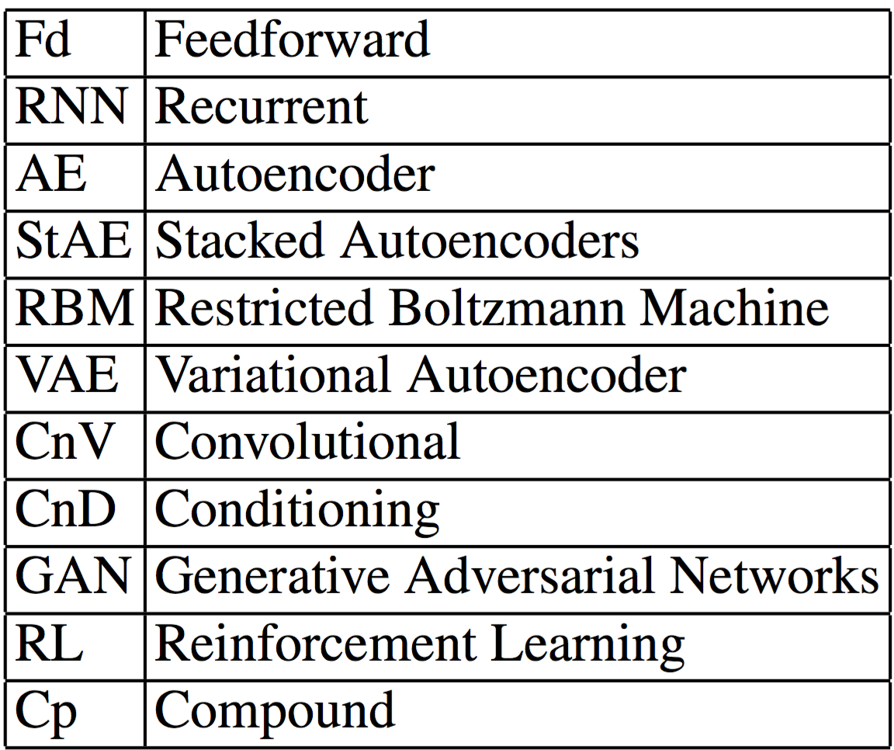
Chapter8 - Analysis
Abbreviations of the Strategies
Abbreviations of the Architectures

Slide 39
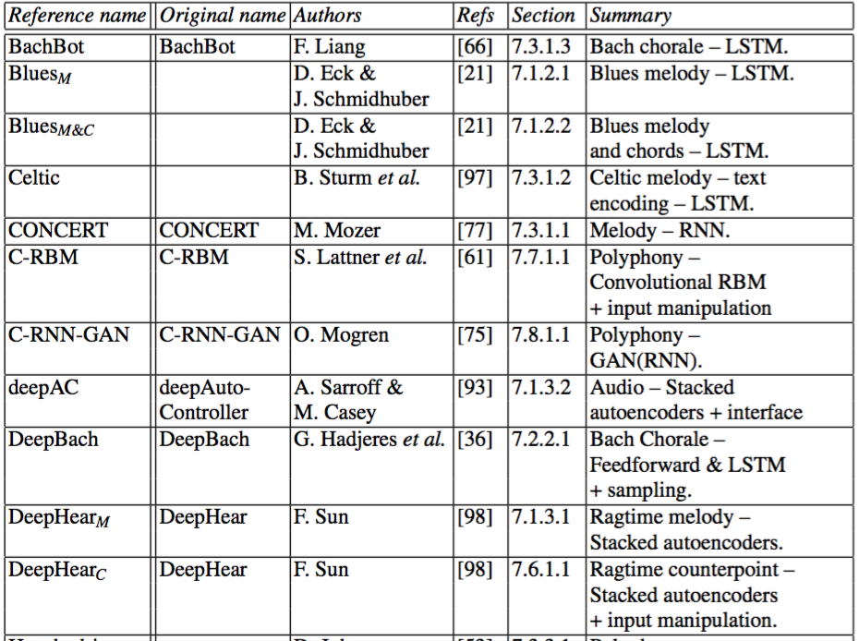
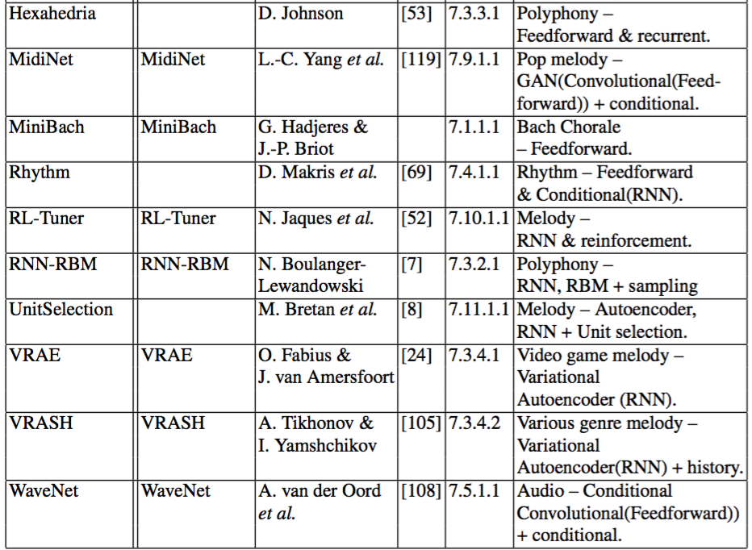

Slide 40
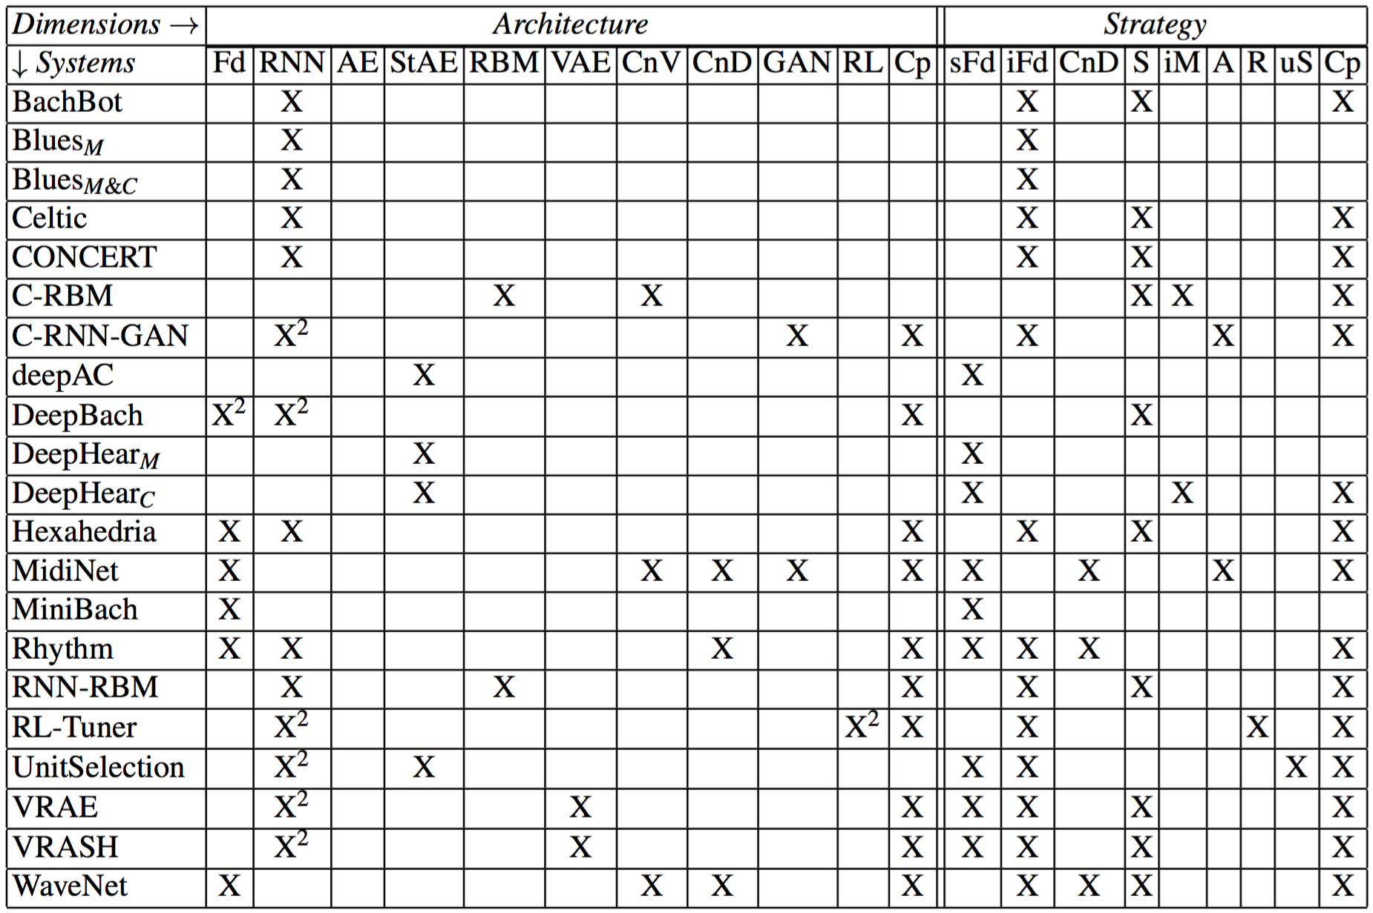

Slide 41
Chapter10 - Discussion
Convolution vs Recurrent
Adversarial and Beyond - Generative Latent Optimization (GLO)
Transfer learning
Evaluation
User Interaction , Adaptive
Structure
Originality
Explanation
Notes:
Convolutions - 較為 快速 且 容易parallel 如果真的要大量便宜且實際使用 RNN不合適 ( wavenet )
Recurrent – 需要參考到歷史的所以ＲＮＮ較合適 MidiNet
GANs and to autoencoders is Generative Latent Optimization (GLO) GLO在圖片上的應用很多 但在音樂上的還很少
Pretrain 還很少有做的 作者認為這是一個不錯的方式
Evaluation –many criteria 結果好不好？ 準確度 相似度 ？ 一個很好很難另一種也很好
User interaction – 很難衡量好不好 通常無法講出哪裡好或哪裏不好 假設能夠詳述 仍不容易改進 train不能改 也許可以跟進generated function
Structure – 通常不太會考量high level structure ,ex : jazz - AABA top-dwon
Ｏriginality 原創性 作者給的解法 用ＧＡＮ塞入一堆曲風相異的歌曲 產出的歌曲在說是新的類型

Slide 43
Chapter10 - Discussion
Convolution vs Recurrent
Adversarial and Beyond - Generative Latent Optimization (GLO)
Transfer learning
Evaluation
User Interaction , Adaptive
Structure
Originality
Explanation
Notes:
Convolutions - 較為 快速 且 容易parallel 如果真的要大量便宜且實際使用 RNN不合適 ( wavenet )
Recurrent – 需要參考到歷史的所以ＲＮＮ較合適 MidiNet
GANs and to autoencoders is Generative Latent Optimization (GLO) GLO在圖片上的應用很多 但在音樂上的還很少
Pretrain 還很少有做的 作者認為這是一個不錯的方式
Evaluation –many criteria 結果好不好？ 準確度 相似度 ？ 一個很好很難另一種也很好
User interaction – 很難衡量好不好 通常無法講出哪裡好或哪裏不好 假設能夠詳述 仍不容易改進 train不能改 也許可以跟進generated function
Structure – 通常不太會考量high level structure ,ex : jazz - AABA top-dwon
Ｏriginality 原創性 作者給的解法 用ＧＡＮ塞入一堆曲風相異的歌曲 產出的歌曲在說是新的類型

Slide 45
Chapter10 - Discussion
Convolution vs Recurrent
Adversarial and Beyond - Generative Latent Optimization (GLO)
Transfer learning
Evaluation
User Interaction , Adaptive
Structure
Originality
Explanation
Notes:
Convolutions - 較為 快速 且 容易parallel 如果真的要大量便宜且實際使用 RNN不合適 ( wavenet )
Recurrent – 需要參考到歷史的所以ＲＮＮ較合適 MidiNet
GANs and to autoencoders is Generative Latent Optimization (GLO) GLO在圖片上的應用很多 但在音樂上的還很少
Pretrain 還很少有做的 作者認為這是一個不錯的方式
Evaluation –many criteria 結果好不好？ 準確度 相似度 ？ 一個很好很難另一種也很好
User interaction – 很難衡量好不好 通常無法講出哪裡好或哪裏不好 假設能夠詳述 仍不容易改進 train不能改 也許可以跟進generated function
Structure – 通常不太會考量high level structure ,ex : jazz - AABA top-dwon
Ｏriginality 原創性 作者給的解法 用ＧＡＮ塞入一堆曲風相異的歌曲 產出的歌曲在說是新的類型

Slide 47
END
Future work
Speed
Waveform - sample time / other structure
(Wavenet , GRUV ,chord2Vec)
MIDI – MidiNet , DeepBatch ,DeepHear , Rhythm Generation System
Notes:
Speed -normalize （目前沒看到）
Waveform –struture CNN & RNN
MIDI

